Slide 1
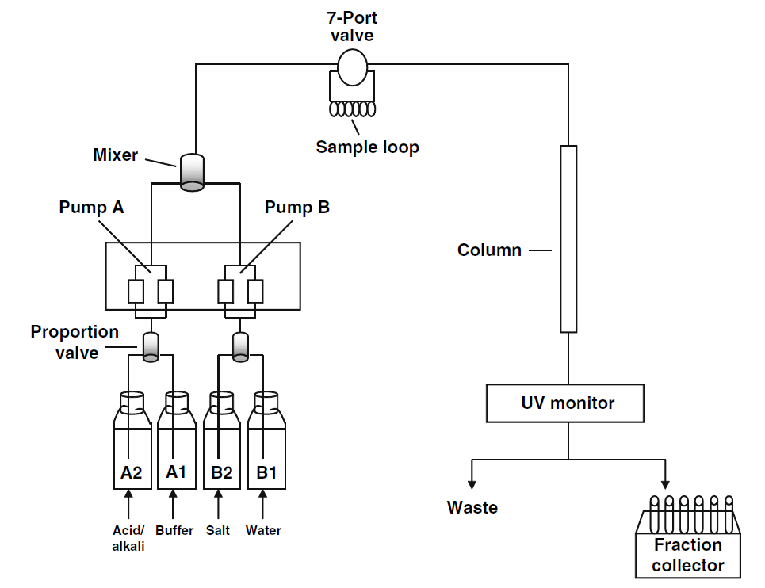
Starting buffer
Elution buffer

